Slide 1





Clearwater Zoning Bylaw Update
POLICY DIRECTION DISCUSSION
TRUE Consulting: July 21, 2026

Slide 2
Context & Update
01
SECTION

Slide 3

Project Update
OVERVIEW
Zoning bylaw updates are underway to align with the OCP.
The Zoning Bylaw must be consistent with the policies in the OCP such as:
  Housing (types, tenures and housing needs)
  Land uses and density
  Siting, landscaping and parking
  Employment lands
Step 1
OCP Adoption
March 2026
Step 2
Project Initiation
April 2026
Step 3
Technical Review
April – June 2026
Step 4
Bylaw Preparation
June – August 2026
Step 5
Final Zoning Bylaw
September 2026
Project Timeline

Slide 4
Purpose of Today’s Discussion
OVERVIEW
Gather Council direction and feedback on major policy directions including:
  Town Centre Zone
  Additional Dwelling Units Policy
  Short Term Rentals Policy Options

Slide 5
Mixed-Use Town Centre
02
SECTION

Slide 6
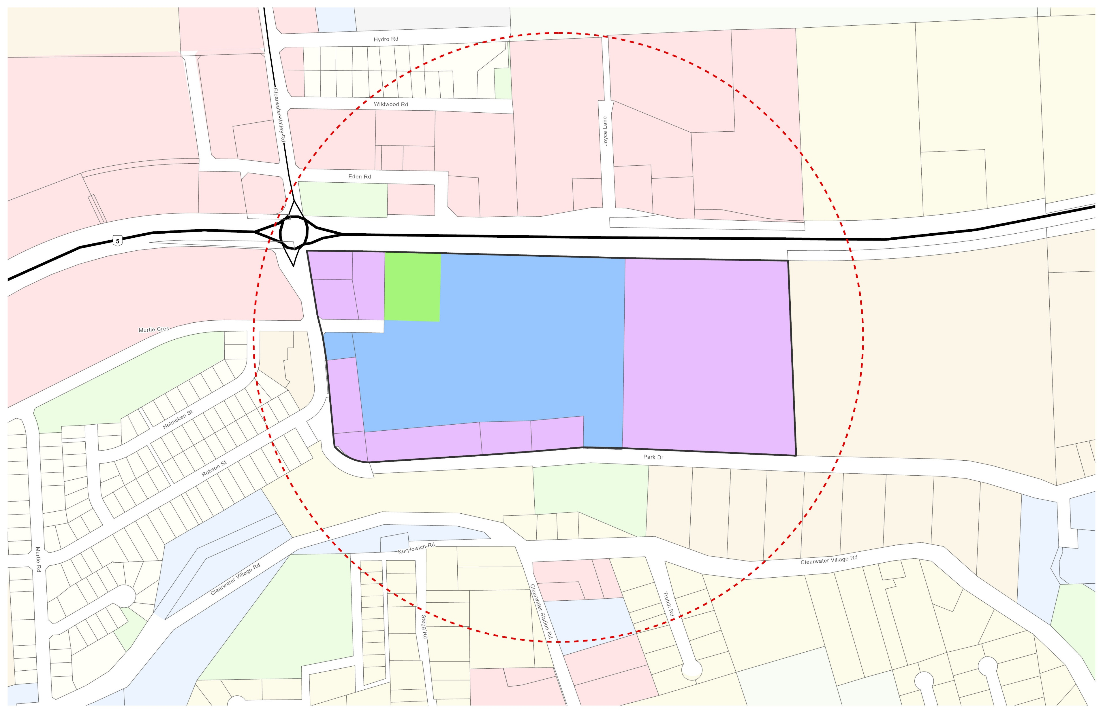
Mixed-Use – Town Centre
NEW ZONE
The Clearwater Official Community Plan identifies the location of a new Town Centre Land Use.
The Town Centre Zone will be applied to the lands shown in purple.

Slide 7
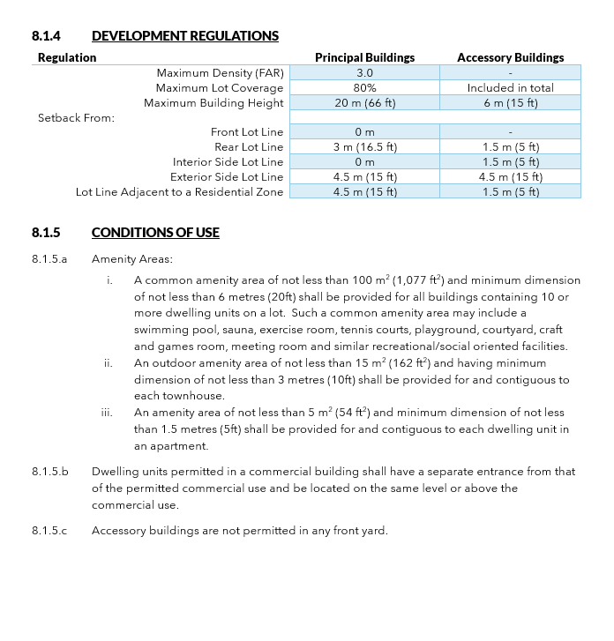
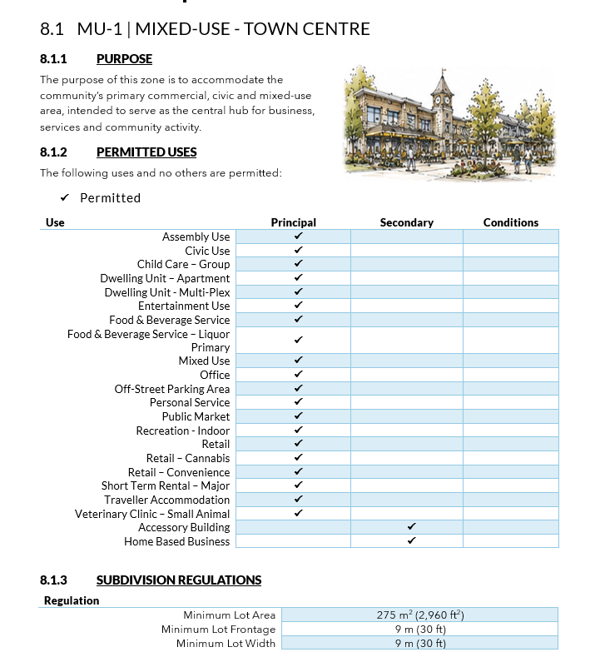
Mixed-Use – Town Centre
NEW ZONE
PURPOSE
The purpose of this zone is to accommodate the community’s primary commercial, civic and mixed-use area, intended to serve as the central hub for business, services and community activity.

Slide 8
Mixed-Use – Town Centre
NEW ZONE
PERMITTED USES
The following uses and no others are permitted:
Use | Principal | Secondary
Assembly Use
Civic Use
Child Care – Group
Dwelling Unit – Apartment
Dwelling Unit - Multi-Plex
Entertainment Use
Food & Beverage Service
Food & Beverage Service – Liquor Primary
Mixed Use
Office
Off-Street Parking Area
Personal Service
Public Market
Recreation - Indoor
Retail
Retail – Cannabis
Retail – Convenience
Short Term Rental – Major
Traveller Accommodation
Veterinary Clinic – Small Animal
Accessory Building
Home Based Business

Slide 9
Mixed-Use – Town Centre
NEW ZONE
SUBDIVISION REGULATIONS
DEVELOPMENT REGULATIONS
Regulation
Minimum Lot Area | 275 m² (2,960 ft²)
Minimum Lot Frontage | 9 m (30 ft)
Minimum Lot Width | 9 m (30 ft)
Regulation | Principal Buildings | Accessory Buildings
Maximum Density (FAR) | 3.0 | -
Maximum Lot Coverage | 80% | Included in total
Maximum Building Height | 20 m (66 ft) | 6 m (15 ft)
Setback From:
Front Lot Line | 0 m | -
Rear Lot Line | 3 m (16.5 ft) | 1.5 m (5 ft)
Interior Side Lot Line | 0 m | 1.5 m (5 ft)
Exterior Side Lot Line | 4.5 m (15 ft) | 4.5 m (15 ft)
Lot Line Adjacent to a Residential Zone | 4.5 m (15 ft) | 1.5 m (5 ft)

Slide 10
Mixed-Use – Town Centre
NEW ZONE
CONDITIONS OF USE
8.1.5.a Amenity Areas:
    A common amenity area of not less than 100 m² (1,077 ft²) and minimum dimension of not less than 6 m (20ft) shall be provided for all buildings containing 10 or more dwelling units on a lot. Such a common amenity area may include a swimming pool, sauna, exercise room, tennis courts, playground, courtyard, craft and games room, meeting room and similar recreational/social oriented facilities.
    An outdoor amenity area of not less than 15 m² (162 ft²) and having minimum dimension of not less than 3 m (10ft) shall be provided for and contiguous to each townhouse.
    An amenity area of not less than 5 m² (54 ft²) and minimum dimension of not less than 1.5 m (5ft) shall be provided for and contiguous to each dwelling unit in an apartment.
8.1.5.b Dwelling units permitted in a commercial building shall have a separate entrance from that of the permitted commercial use and be located on the same level or above the commercial use.
8.1.5.c Accessory buildings are not permitted in any front yard.

Slide 11
Additional Dwelling Units (ADU’s)
03
SECTION

Slide 12
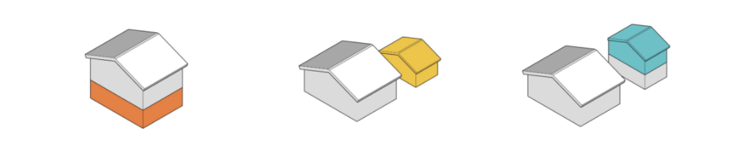
Additional Dwelling Units
EXPANDED POLICY
What is an Additional Dwelling Unit (ADU)?
An ADU is a self-contained dwelling unit that is secondary to a principal dwelling unit on the same legal lot. An ADU may take the form of a secondary suite, carriage suite, or garden suite and must be established in accordance with a valid building permit and may not be strata titled.
Secondary Suite
Garden Suite
Carriage Suite

Slide 13
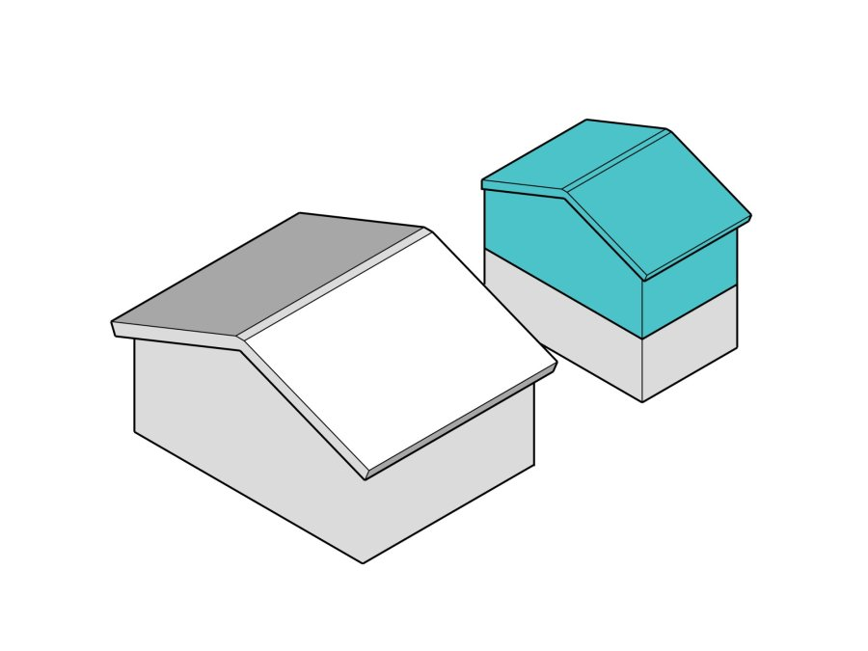
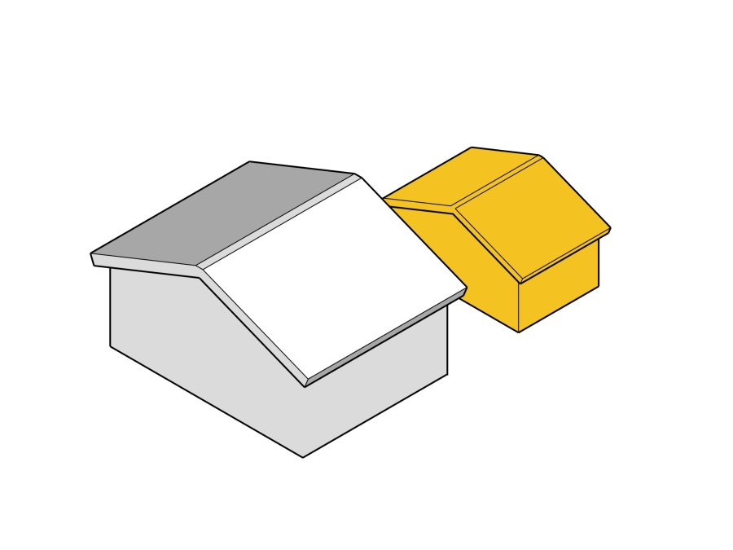
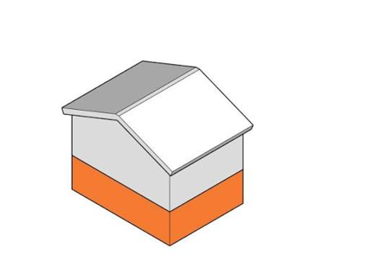
Additional Dwelling Units
EXPANDED POLICY
Carriage Suite:
means a self-contained, two-storey dwelling unit that is separate, subordinate in size, and accessory to the principal dwelling, having a footprint no greater than 80 m² (861 ft²) and having not more than 95 m² (1023 ft²) of residential living space.
Garden Suite:
means a self-contained, one-storey dwelling unit that is separate, subordinate in size, scale and massing and accessory to the principal dwelling, having a total gross floor area of not more than 80 m² (861 ft²).
Secondary Suite:
means a residential use consisting of a self-contained dwelling unit wholly contained within the same building as a single-detached dwelling not exceeding 49% of the gross floor area of the principal dwelling.

Slide 14
Additional Dwelling Units
EXPANDED POLICY
Requirements include:
Building permit
1.5 m wide pathway
3 m building separation
1 additional parking space
15 m² of private amenity space
No rooftop decks
Connection to water and sewer
4,000 m² lot area for septic or 1 ha lot area for well and septic

Slide 15
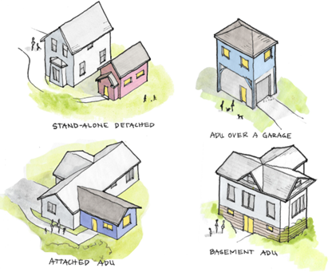
Additional Dwelling Units
EXPANDED POLICY
Where are ADUs currently permitted?
ADUs are currently permitted in the RL-1 (Rural) Zone on lots larger than 2 ha not within the ALR.
Secondary Suites are currently permitted in all single-family residential zones.

Slide 16
Additional Dwelling Units
EXPANDED POLICY
Where are the conditions for ADUs in the draft Zoning Bylaw?
Permitted in all low and medium density single-detached zones.
Maximum density of 2-units per parcel, (1 duplex or 1 single-detached dwelling with 1 ADU.
Must prove sufficient servicing capacity.
Land located in the ALR may have additional allowances or regulations.

Slide 17
Short-Term Rentals
04
SECTION

Slide 18
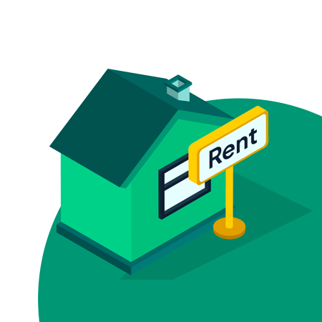
Short-Term Rentals
NEW POLICY
Prior to finalizing the short-term rental (STR) policies of the Zoning Bylaw, we are seeking feedback and direction from Council on the following:
Definition including length of stay
Categorization of short-term rental use
Conditions of use
Applicable zones

Slide 19
Short-Term Rentals
NEW POLICY
The OCP addresses short-term rentals with the following definition and policies:
Short-term Rental (STR): A dwelling unit or multiple dwelling units that are rented for a continuous period of less than 30 days.
Housing Diversity 2.2.2 (j): Accommodate residential-based tourism, such as short-term vacation rentals, or nightly rentals throughout the District.
Tourism Sector 2.6.3(k) STRs are permitted only within the host’s principal residence or an accessory residential suite located on the same property (such as a basement suite), provided the operator obtains and maintains a valid business licence from the District.

Slide 20
Short-Term Rentals
NEW POLICY
Clearwater’s current STR policy includes:
Temporary Use Permit (TUP): A regulatory tool to permit a commercial use not otherwise allowed in the zone. Issued for up to a 3-year term, option to renew for 1 additional term.
Business Licence: Includes information such as the operator, local contact person, listing information, required licence number display, and ongoing operating requirements.
Provincial Registration: A provincial registration number is required to list the STR on platforms such as Airbnb, Vrbo, Expedia, Booking…

Slide 21

Short-Term Rentals
NEW POLICY
Why zoning regulations may offer a simpler solution:
Permanent land use - TUPs are temporary
Reduced cost, time and uncertainty for operators
Reduces administrate cost for the District

Slide 22
Short-Term Rentals
NEW POLICY
The Zoning Bylaw proposes the following STR definitions:
Short-term Rental: means the use of a dwelling unit for temporary overnight accommodation for a period of less than 30 consecutive days.
Short-term Rental – Major: means a short-term rental that encompasses an entire principal dwelling unit and/or an entire parcel.
Short-term Rental – Minor: means a short-term rental within an entire accessory dwelling unit such as a basement suite, carriage suite, or garden suite and includes an owner that lives on the parcel as their principal residence.

Slide 23
Short-Term Rentals
NEW POLICY
Zoning Bylaw – General Regulations for STRs:
Building Permit
Compliance with BC Building Code and applicable local and Provincial enactments
Building and Fire Inspection
Valid business licence
Additional parking space
Payment of applicable charges and fees
Connect to water and sanitary sewer or
Approved water supply and sanitary sewage disposal system, may include a reserve septic dispersal area

Slide 24
Option
01
SHORT-TERM RENTALS
Short-term Rental Minor
Allow STR – Minor as a permitted use all housing zones that permit single-detached dwellings and ADUs (secondary suites, carriage or garden suites).
Short-term Rental - Major
Allow STR – Major as a permitted use in mixed use, general and recreational commercial zones.

Slide 25
Option
02
SHORT-TERM RENTALS
Short-term Rental Minor
Allow STR – Minor as a permitted use all housing zones that permit single-detached dwellings and ADUs (secondary suites, carriage or garden suites).
Short-term Rental - Major
STR – Major not permitted.

Slide 26
Option
03
SHORT-TERM RENTALS
Short-term Rental Minor
STR – Minor not permitted.
Short-term Rental - Major
Allow STR Major as a permitted use in mixed-use, general and recreational commercial zones.

Slide 27
Option
04
SHORT-TERM RENTALS
Short-term Rental
Allow STRs as a permitted use without categorization subject to meeting the general regulations of the Zoning Bylaw.
Zoning
STR use can be assigned to specific zones or allowed outright across all zones.

Slide 28
Short-Term Rentals
NEW POLICY
Option 1:
STR – Minor: permitted in all low and medium density residential zones
STR – Major: permitted in all mixed-use, general and recreational commercial zones
Option 2:
STR – Minor: permitted in all low and medium density residential zones
STR – Major: requires TUP or rezoning
Option 3:
STR – Minor: requires TUP or rezoning
STR – Major: permitted in all mixed-use, general and recreational commercial zones
Option 4:
STR: permitted in all zones without categorization
More permissive but higher risk of conflicting use and bylaw enforcement demands
Requires amendment to OCP Policy 2.6.3(k)

Slide 29
Short-Term Rentals
NEW POLICY
 | Option 1: | Option 2: | Option 3: | Option 4:
STR – Minor: permitted in low and medium density residential zones
STR – Major: permitted in mixed-use, general and recreational commercial zones
STR: permitted in all zones without categorization

Slide 30
Thank You!
POLICY DIRECTION DISCUSSION

